Slide 1

Introduction to Artificial Intelligence
Working Group - 3
Tutors:
Janek & Joana

Slide 2
Discussion about previous lectures
Guest Lecture(s):
Was the lecture clear?
What are your take home messages?
Was it new to you?
What did you like the most? What did you not like?
Does it apply to your project? How?
Methodology lecture(s):
Was the lecture clear?
What are your take home messages?
Was it new to you?
What did you like the most? What did you not like?
Do you know how to integrate it in your project?
Notes:
Adjust the content to number of methodology and guest lectures, i.e., which methodology or guest lecture will you integrate in your project?

Slide 3
Working Groups & Project Groups
Working Group | Project group number | Day | Time | Location | Student assistant | Tutor
1 | 1,2,3,4,5 | Tuesdays | 13:30 -15:15 | NU-4B43 (34/17T | Jilesen + Orkun | Yaman A.
2 | 6,7,8,9,10 | Thursdays | 17:30 - 19:15 | BV-0H19 (32/16T) | Federico + Jilesen | Postma, B
3 | 11,12,13,14,15 | Tuesdays | 13:30 -15:15 | NU-3A67 (32/16T) | Jan + Joana | Harmelen, F.A.H. van
4 | 16,17,18,19,20 | Tuesdays | 13:30 -15:15 | NU-6A52 (28/14T) | Jahreel + Alisa | Ligthart, M.E.U.
5 | 21,22,23,24,25 | Thursdays | 13:30 -15:15 | NU-2B05 (24/12T) | Auke + Orkun | Tiddi, I
6 | 26,27,28,29,30 | Tuesdays | 13:30 -15:15 | NU-2B17 (24/12T) | Federico + Auke | da Silva Miras de Araujo, K
7 | 31,32,33,34,35 | Thursdays | 17:30 - 19:15 | NU-6A52 (28/14T) | Jahreel + Alisa | Baraka, K.
8 | 36,37,38,39,40 | Tuesdays | 13:30 -15:15 | NU-5A27 (24/12T | Andreea + Francesca | Schlobach, K.S
9 | 41,42,43,44,45 | Thursdays | 17:30 - 19:15 | NU-4B47 (36/18T | Jan + Joana | Hoogendoorn, M.
10 | 46,47,48,49,50 | Thursdays | 13:30 -15:15 | NU-2B11 (24/12T | Jan + Joana | Klein, M.C.A
11 | 51,52,53,54,55 | Thursdays | 13:30 -15:15 | NU-2B17 (24/12T) | Federico + Jilesen | Gerritsen, C.
12 | 56,57,58,59,60 | Thursday | 17:30 - 19:15 | HG-15A37 (32/16T | Andreea + Francesca | Rekker, L.H.
13 | 61,62,63,64,65 | Thursdays | 13:30 -15:15 | OZW-6A10 (25/12T) | Auke + Orkun | Boer, V. de
Notes:
Make sure that your working group (26/25 students) and Project groups (5 each) has joined the right groups on canvas.
Highlight your working group…

Slide 4
Tutor Groups Sessions
 |  | Presence of TAs & Tutor |  |  | Preferable presence of TAs & Tutors |  |  | Preferable presence of TAs & Tutors
Deadline | Assignment | 1st tutor session | 2nd tutor session | 3rd tutor session | 4th tutor session | 5th tutor session | 6th tutor session | 7th tutor session
15-Sept-23 | Research Problem | Project Group formation + ⬅️ Working on | Presentations
22-Sept-23 | Literature |  | ⬅️ Instructions from TAs and working on it | Presentations
29-Sept-23 | Approach |  |  | ⬅️ Instructions from TAs and working on it | Presentations
6-Oct-23 | Experimental Evaluation |  |  |  | ⬅️ Instructions from TAs and working on it | Presentations
13-Oct-23 | Poster & Video |  |  |  |  | ⬅️ Instructions from TAs and working on it
27-Oct-23 | Final Report |  |  |  |  |  | ⬅️ Instructions from TAs and working on it | Presentations (Feedback from Tutor)
 |  |  |  |  |  |  |  | ⬅️ Tutor feedback adjustment in the final report
Notes:
Explain the slight change in the schedule (lower part)

Slide 5



Presentations
(5 minutes each followed by feedback/questions)

Slide 6

10 minutes break

Slide 7
Evaluation
Draft a plan for the evaluation
How will you know your system will work in reality?
Get inspiration from the lecture and from the relevant papers (also compare with those if you can)!

Slide 8
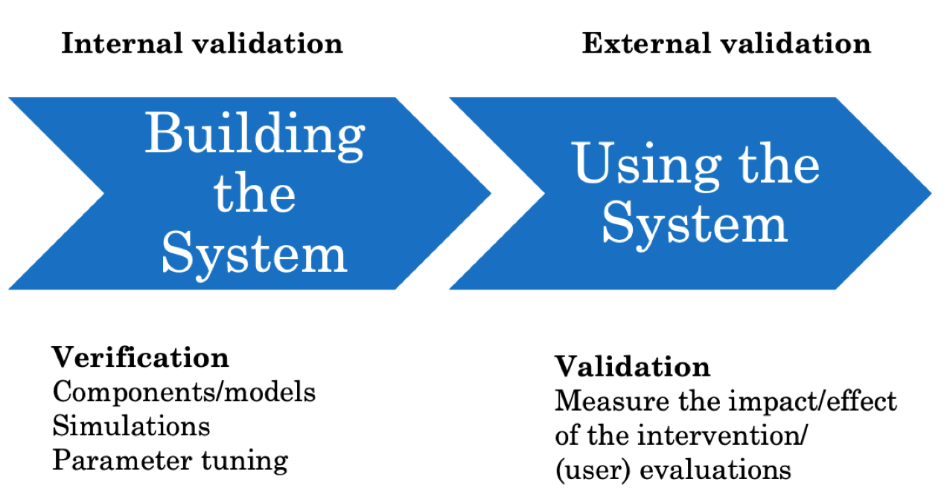
Evaluation
Make a hypothesis to test
2 Questions :
- Internal eval : does the system work internally (train/test, system variations...)
- External eval : does it reach the goal it was designed for?
Be concrete :
- how much data?
- How many participants in the user-study?
- How long will it take?
- How will you measure your goal

Slide 9

Evaluation : questions to start with
- What components should be evaluated separately
- Are single components performing well (loss in the pipeline)?
- How to assess/measure the quality of the components
- What aspects are important for the end user?
- How will these be evaluated?
- When will the evaluation be carried?

Slide 10

Working on Computational Solution

